Slide 1
Analysis: E-Retailer Posts Wrong Price, Refuses to Deliver
Amazon.com in Britain offered iPaq for £7 instead of £275
Orders flooded in
Amazon.com shut down site, refused to deliver unless customers paid true price
Was Amazon.com wrong to refuse to fill the orders?
1-<number>

Slide 2
Rule Utilitarian Analysis
Imagine rule: A company must always honor the advertised price
Consequences
  More time spent proofreading advertisements
  Companies would take out insurance policies
  Higher costs → higher prices
  All consumers would pay higher prices
  Few customers would benefit from errors
Conclusion
  Rule has more harms than benefits
  Amazon.com did the right thing
1-<number>

Slide 3
Kantian Analysis
Buyers knew 97.5% markdown was an error
They attempted to take advantage of Amazon.com’s stockholders
They were not acting in “good faith”
Buyers were in the wrong, not Amazon.com
1-<number>

Slide 4
8.4 Notable Software System Failures
1-<number>

Slide 5
Patriot Missile
Designed as anti-aircraft missile
Used in 1991 Gulf War to intercept Scud missiles
One battery failed to shoot at Scud that killed 28 soldiers
Designed to operate only a few hours at a time
Kept in operation > 100 hours
Tiny truncation errors added up
Clock error of 0.3433 seconds → tracking error of 687 meters
1-<number>

Slide 6
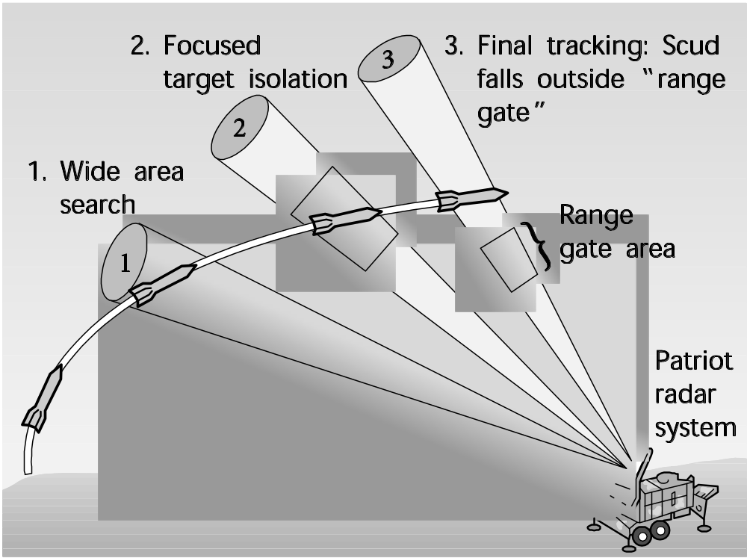
Patriot Missile Failure
Figure from SCIENCE 255:1347. Copyright ©1992 by The American Association for the Advancement of Science. Reprinted with permission.
1-<number>

Slide 7
Ariane 5
Satellite launch vehicle
40 seconds into maiden flight, rocket self-destructed
  $500 million of uninsured satellites lost
Statement assigning floating-point value to integer raised exception
Exception not caught and computer crashed
Code reused from Ariane 4
  Slower rocket
  Smaller values being manipulated
  Exception was impossible
1-<number>

Slide 8
AT&T Long-Distance Network
Significant service disruption
  About half of telephone-routing switches crashed
  70 million calls not put through
  60,000 people lost all service
  AT&T lost revenue and credibility
Cause
  Single line of code in error-recovery procedure
  Most switches running same software
  Crashes propagated through switching network
1-<number>

Slide 9
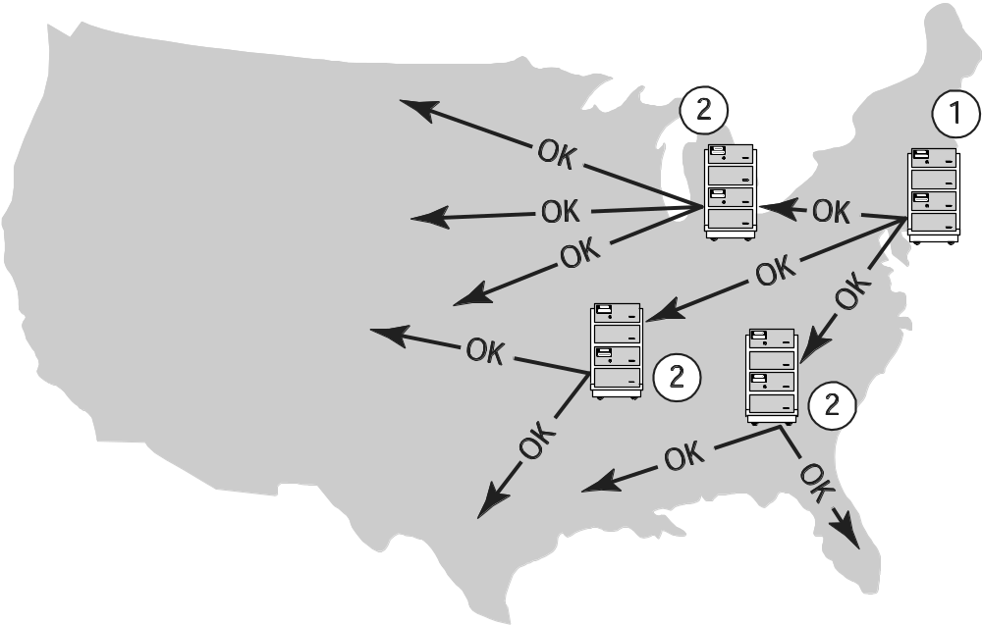
AT&T Long Distance Network Failure
1-<number>

Slide 10
Robot Missions to Mars
Mars Climate Orbiter
  Disintegrated in Martian atmosphere
  Lockheed Martin design used English units
  Jet Propulsion Lab design used metric units
Mars Polar Lander
  Crashed into Martian surface
  Engines shut off too soon
  False signal from landing gear
1-<number>

Slide 11
Denver International Airport
BAE built automated baggage handling system
Problems
  Airport designed before automated system chosen
  Timeline too short
  System complexity exceeded development team’s ability
Results
  Added conventional baggage system
  16-month delay in opening airport
  Cost Denver $1 million a day
1-<number>

Slide 12
Tokyo Stock Exchange
First day of trading for J-Com
Mizuho Securities employee mistakenly enters order to sell 610,00 shares at 1 yen, instead of 1 share at 610,000 yen
Employee overrides computer warning
After sell order posted on exchange’s display board, Mizuho tries to cancel order several times; software bug causes attempts to fail
Mizuho loses $225 million buying back shares
1-<number>

Slide 13
Direct Recording Electronic Voting Machines
After problems with 2000 election, Congress passed Help America Vote Act of 2002
HAVA provided money to states to replace punch card voting systems
Many states used HAVA funds to purchase direct recording electronic (DRE) voting machines
Brazil and India have run national elections using DRE voting machines exclusively
In November 2006 1/3 of U.S. voters used DRE voting machines
1-<number>

Slide 14
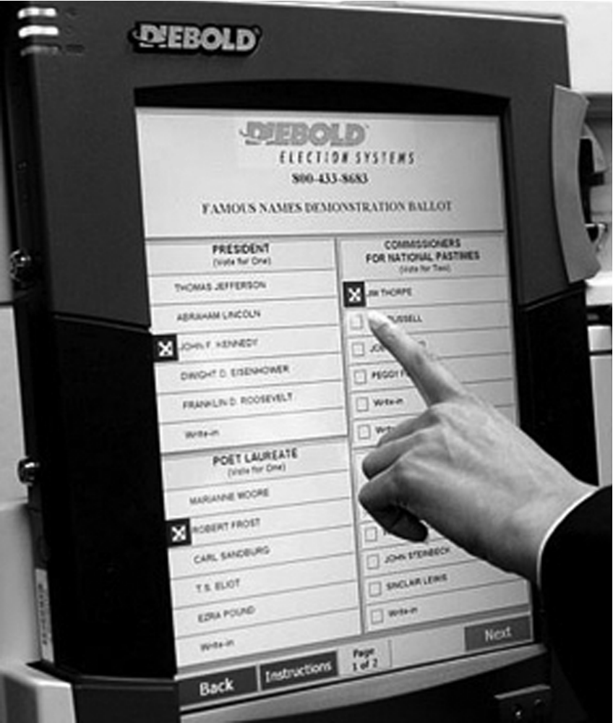
Diebold Electronic Voting Machine
© AP Photo/Rogelio Solis
1-<number>

Slide 15
Issues with DRE Voting Machines
Voting irregularities
  Failure to record votes
  Overcounting votes
  Misrecording votes
Lack of a paper audit trail
Vulnerability to tampering
Source code a trade secret, can’t be examined
Possibility of widespread fraud through malicious programming
1-<number>

